Slide 1
Supervised Machine Learning for Effective Missile Launch Based on Beyond Visual Range Air Combat Simulations
Joao P. A. Dantas,1st Lt
Decision Support Systems Subdivision
Institute for Advanced Studies
Brazilian Air Force

Slide 2
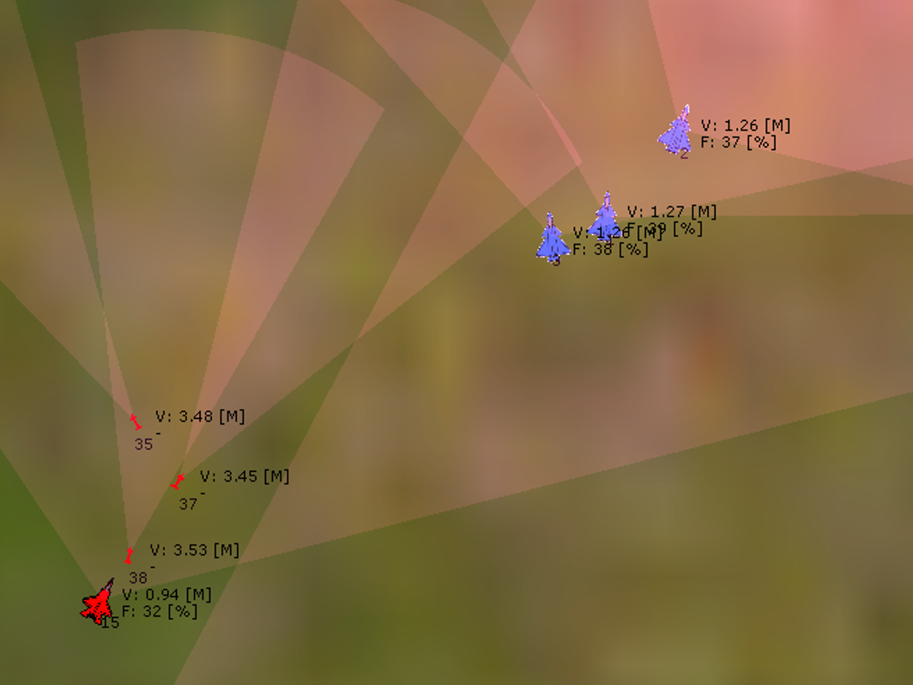
INTRODUCTION
Beyond Visual Range (BVR) Air Combat: sensors and missiles
New technologies in the modern warfare
Constructive Simulations: autonomous agents
Some research addressed the application of artificial intelligence, game theory, and heuristics in modeling decision-making for autonomous agents in different phases of simulated BVR air combat

Slide 3
RELATED WORK
Threat assessment and target selection
Fuzzy logic and Bayesian network: Rao et al. (2011).
Case-Based Behavior Recognition: Borck et al. (2015)
Zero-sum game: Ma et al. (2019)
Genetic algorithm with deep learning: Li et al. (2020)
Bayesian optimization: Fu et al. (2021)
Neural network: Yao (2021)
Selection and execution of tactical maneuvers
Bayesian networks: Du and Liu (2010)
Behavior trees: Yao et al. (2015)
Finite state machines: Toubman et al. (2016)
Reasoning based on objectives: Floyd et al. (2017)
Simulated annealing: Weilin et al. (2018)
Minimax method: Kang et al. (2019)
Genetic algorithm: Kuroswiski (2020)
Hierarchical multi-Objective evolutionary algorithm: Yang et al. (2020)
Markov decision processes: Piao et al. (2020)
Zero-sum differential game: Garcia et al. (2021)
Deep reinforcement learning: Hu et al. (2021)

Slide 4
RELATED WORK
Decision-making process of launching a missile
Ha et al. (2018)
Modeled the BVR air combat between two aircraft swarms as a zero-sum stochastic game
Probabilistic function: the target’s evasive ability, the missile’s speed on the final approach, and the accuracy of the target’s information to guide the missile
It has not been tested in simulations with higher fidelity concerning real BVR air combat
All aircraft in the same swarm fire at the same time
The missiles can pursue targets without the need for support from the radar aircraft
Lima Filho et al. (2021)
Modeled the BVR air combat between two aircraft and analyze the missile launch process
Single machine learning method was employed
One aircraft each team

Slide 5
CONTRIBUTION
Estimate the most effective moment for launching missiles during a BVR air combat
Supervised Machine Learning Techniques can streamline the missile success predictions for real-time applications
The missiles could not hit their targets in most of the scenarios: imbalanced dataset
Resampling techniques were employed to improve the predictive model.
“First work to address the imbalance in the missile launch results within air combat simulation.”

Slide 6
METHODOLOGY
1
2
3
4
5
6
7
Design of experiments
Collect the data from the missile launches
Model training and hyperparameter tuning
Define BVR air combat scenarios
Run simulations faster than in real-time
Preprocessing and exploratory data analysis
Evaluation

Slide 7
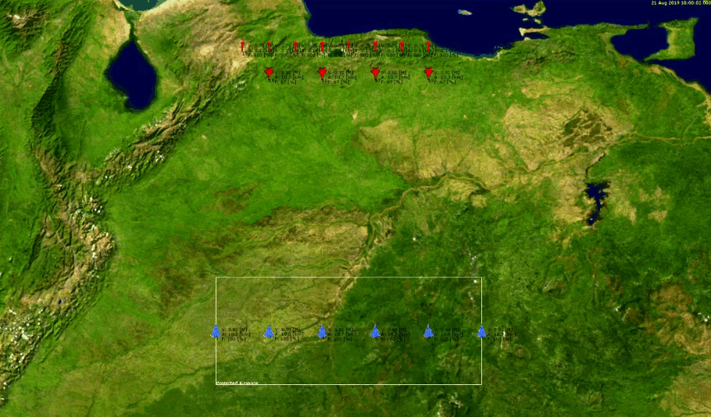

SCENARIO DESCRIPTION
Two forces that engage each other in a tropical area
Blue
Combat Air Patrol (CAP)
4- or a 6-aircraft squadron
Fourth-generation and Fifth-generation
Red
Fighter Sweep
4-aircraft squadron
Multi-role fighters

Slide 8
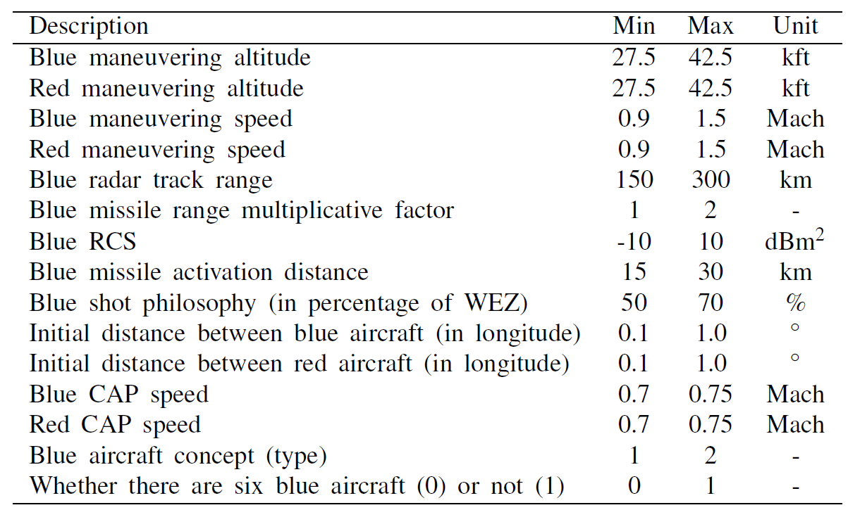
DESIGN OF EXPERIMENTS
Latin Hypercube Sampling (LHS)
240 cases as simulation inputs
Each executed 30 times with different seeds (probability of kill and behavior evaluation delays)
7200 simulations
All aircraft destroyed or 30 minutes
Faster than in real-time

Slide 9
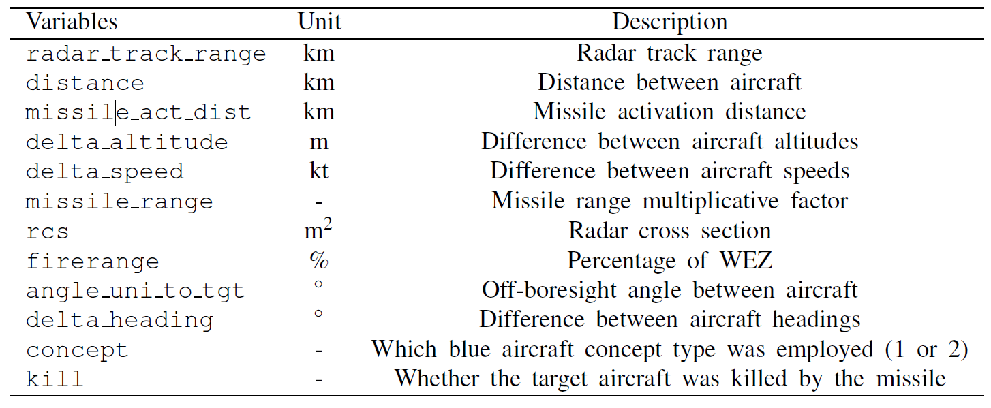
VARIABLES

Slide 10
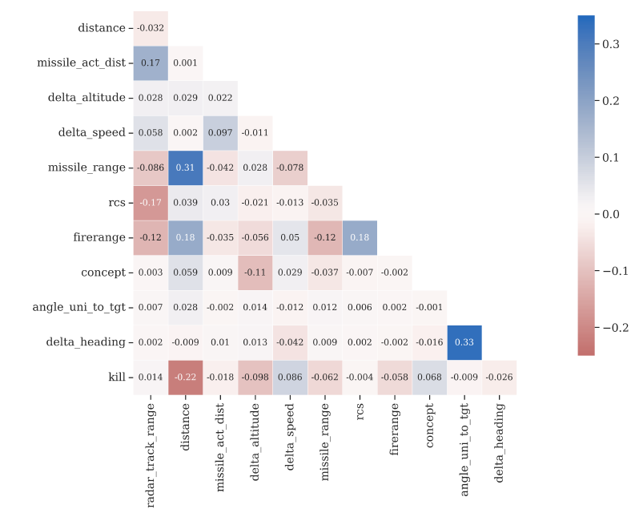
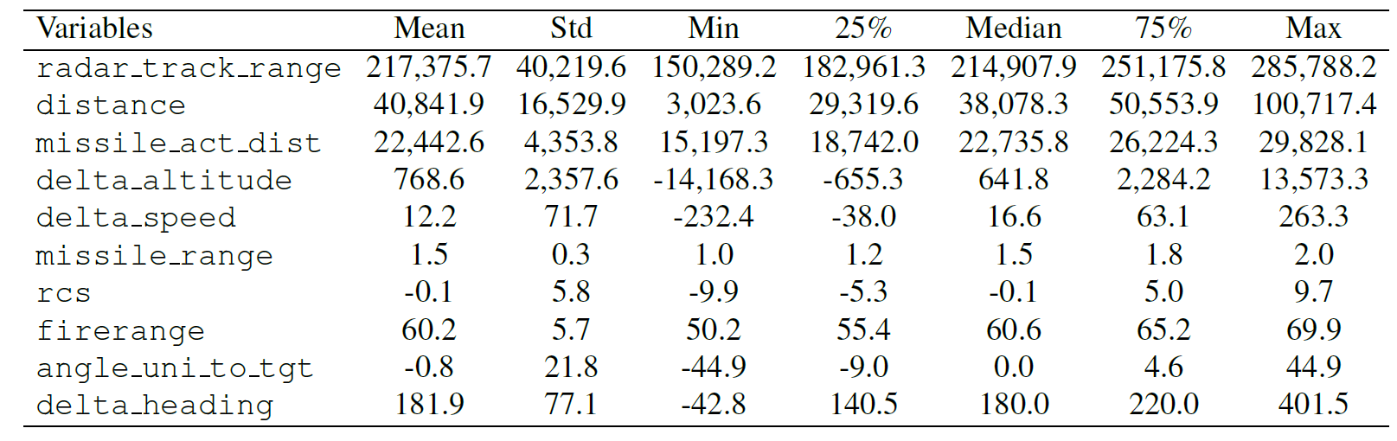
EXPLORATORY DATA ANALYSIS

Slide 11
MODEL TRAINING AND EVALUATION
Scikit-learn and XGBoost libraries
Data Scaling: Support Vector Machines, Artificial Neural Networks, K-Nearest Neighbors and Naive Bayes (it is not required for Linear Regression, Random Forest and Extreme Gradient Boosting)
Grid search algorithm
Train-validate-test split
85% for training and validation using a 5-fold cross-validation technique
15% for testing
Accuracy, Precision, Recall, and F1-score
Inference Time

Slide 12
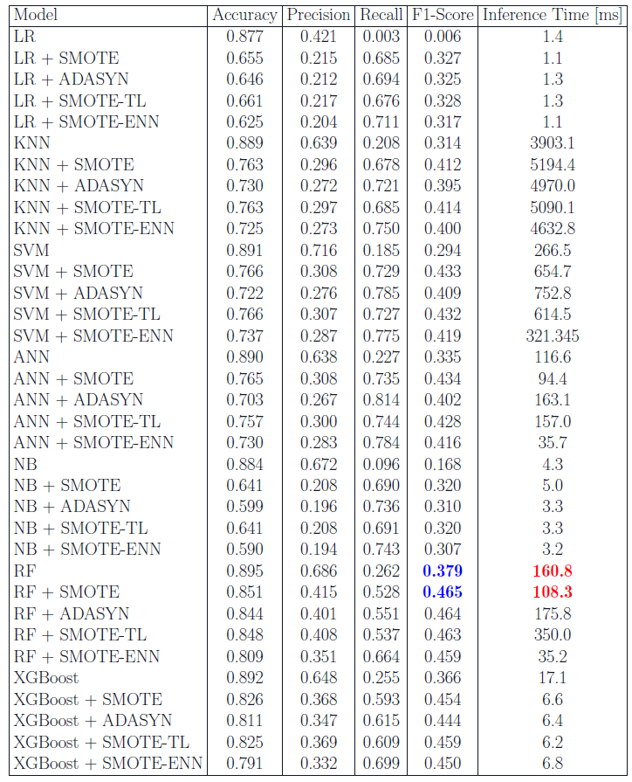
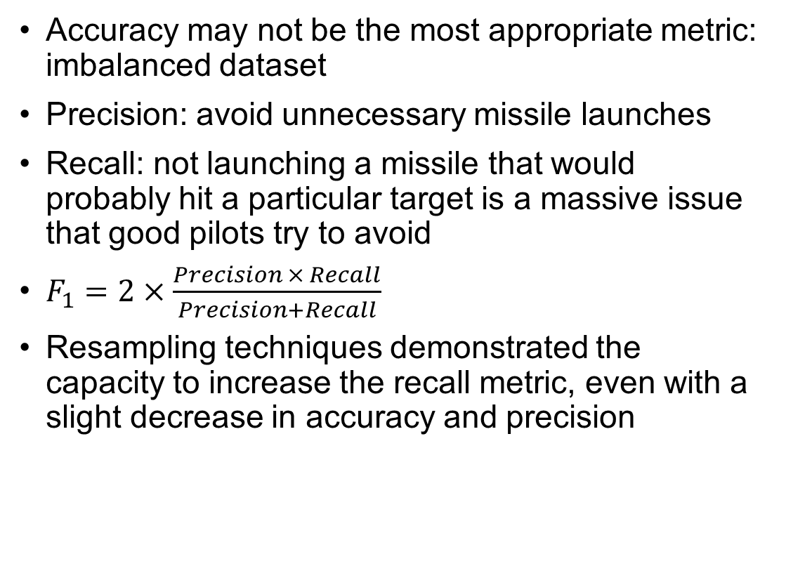
MODEL METRICS
Accuracy may not be the most appropriate metric: imbalanced dataset
Precision: avoid unnecessary missile launches
Recall: not launching a missile that would probably hit a particular target is a massive issue that good pilots try to avoid
$F_{1}=2×\frac{Precision × Recall}{Precision+Recall}$
Resampling techniques demonstrated the capacity to increase the recall metric, even with a slight decrease in accuracy and precision

Slide 13
CONCLUSIONS
Develop decision support tools that may improve flight quality in BVR air combat
These models might enhance the missile launching process by unmanned combat aerial vehicles (UCAV) or aid pilots in real air combat scenarios
For future work
Analyze different scenarios with multiple aircraft equipped with other missiles
Analyze not just the missile launching moment but a sequence of several timeframes to understand better the coordination of future events in the air combat scenario
Develop different sampling strategies that allow the choice of other input variables to improve the dataset to be analyzed

Slide 14
ACKNOWLEDGMENTS
Finep: Reference: grant nº 2824/20
CNPq -- National Research Council of Brazil: grant nº 304134/2-18-0

Slide 15

CONTACT
Code: github.com/jpadantas/effective-missile-launch
E-mail: dantasjpad@fab.mil.br
Website: www.joaopadantas.com

